Slide 1
AirFPGA The NetFPGA SDR Platform
NetFPGA Workshop 2009
James Hongyi Zeng, John W. Lockwood
G. Adam Covington
Alexander Tudor

Slide 2
Outlines
SDR - Software Defined Radio
Limitation of current SDRs
Anatomy of AirFPGA

Slide 3
Outlines
SDR - Software Defined Radio
Limitation of current SDRs
Anatomy of AirFPGA

Slide 4
What’s Software Defined Radio?
A radio platform: waveform → data packets
Hardware → Software
mixers, filters, amplifiers
modulators, detectors
FFT, downsampler
Highly configurable (“Software Defined”)
Bluetooth, Wi-Fi, Radio(AM/FM), Cellular, HDTV

Slide 5
Ideal SDR Architecture
Analog to Digital Converter
(ADC)
RF Frontend
Digital Processor
(PC/FPGA/etc.)

Slide 6
Popular Research SDR System 1: USRP (Universal Software Radio Peripheral)
Ettus Research LLC
12-bit, 64 MS/s ADC
Altera EP1C12 FPGA
USB 2.0 to CPU
Designed for GNU Radio
GNU Radio (Software on CPU)
A collection of DSP toolboxes
Python / C++

Slide 7
Popular Research SDR System 2: WARP (Wireless Open Access Research Platform)
Rice University
16-bit, 160MS/s ADC (on RF Daughter Board)
Xilinx XC2VP70 Virtex-II Pro
All processing done on FPGA
Software Development
FPGA based
C/Matlab -> HDL
Xilinx Platform Studio
Xilinx System Generator

Slide 8
Outlines
SDR - Software Defined Radio
Limitation of current SDRs
Anatomy of AirFPGA

Slide 9
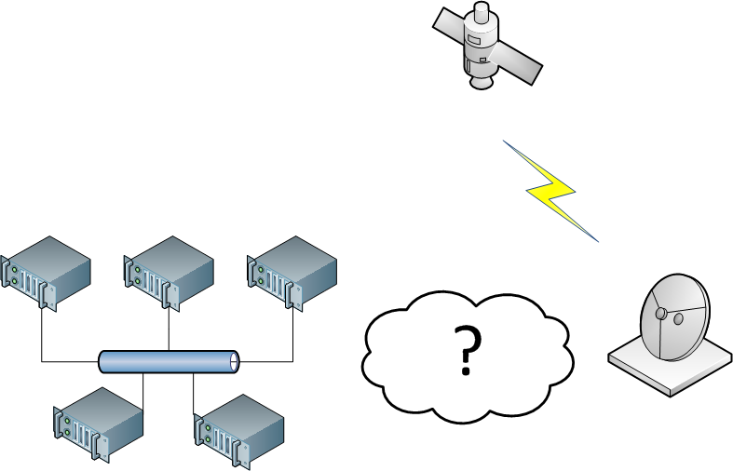
Research Problem 1: Satellite Receiving
Monitor a band of satellite signal.
Signal is so complex that a computer cluster is needed
Antenna in Big Dish and the cluster is in Gates Building (~3 miles apart)

Slide 10
USRP/WARP Remote Processing
WARP
FPGA is supposed to do everything.
No way to a “computer” cluster
USRP
USB Cable?
Little data can be transferred (480Mbps) even you have one.

Slide 11
Research Problem 2: Location Diversified MIMO
Multiple APs in different places
Handheld talks to all APs at the same time
APs share the information to employ the best policy

Slide 12
USRP/WARP Board-to-Board Communication
WARP
Xilinx Multi-Gigabit Transceivers (MGT)
Special Equipment (Cable, Jack) required
USRP
No

Slide 13
What’s missing?
Data Acquisition
Clicked!
Data Processing
Data Acquisition and Data Processing highly coupled, making it difficult for
Remote Processing
Multi-node coordination (scalability)
Share the computing resource

Slide 14
Solution
Data Acquisition
Data Acquisition
Data Acquisition
Data Processing
Carve out a simple data acquisition unit
Configurable
High-speed, universal interface

Slide 15
Solution
Remote Processing
Centralized multi-node coordination
Share the computing resource
Data Acquisition
Data Acquisition
Data Processing
Data Acquisition

Slide 16
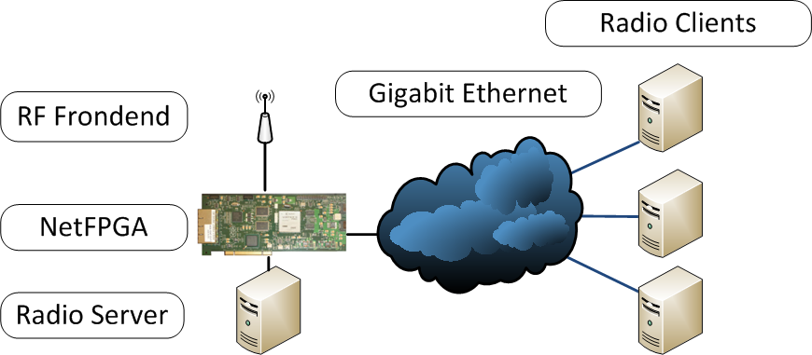
Our Approach - AirFPGA

Slide 17
Outlines
SDR - Software Defined Radio
Limitation of current SDRs
Anatomy of AirFPGA

Slide 18
AirFPGA – An SDR Platform
RF Frontend
Daughterboard connected to NetFPGA
High Performance ADC + Antenna
Configurable Digital Processing Modules
On Xilinx Virtex FPGA
Waveform → UDP/IP packet
High Speed Interface to processing unit
4x1Gbps Ethernet Port
Can upgraded to 4x10Gbps with the new NetFPGA

Slide 19
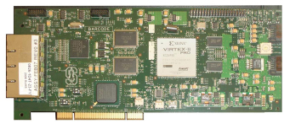
NetFPGA – Core of AirFPGA
34 General Purpose I/O pins
64MB DRAM
4x1Gbps Ethernet Port
Virtex II Pro FPGA
4.5MB SRAM

Slide 20
Inside NetFPGA
Data Processing Units
User Defined Packet Format
User Defined Radio Protocol

Slide 21
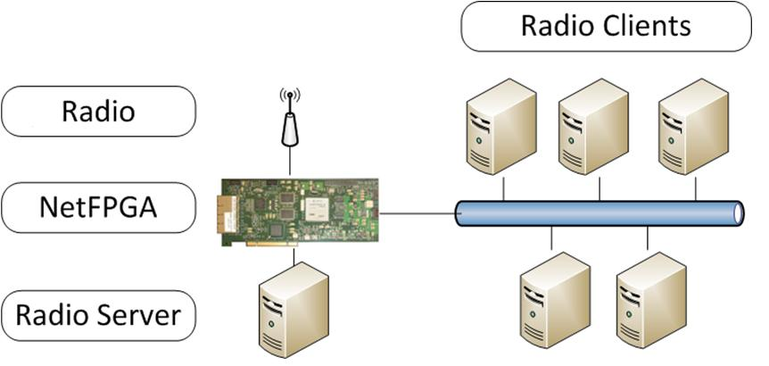
How AirFPGA works?
RF
IP Packet

Slide 22
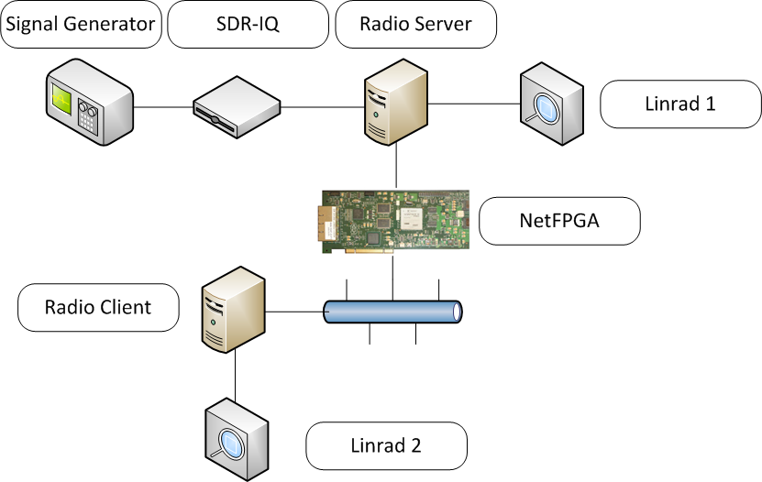
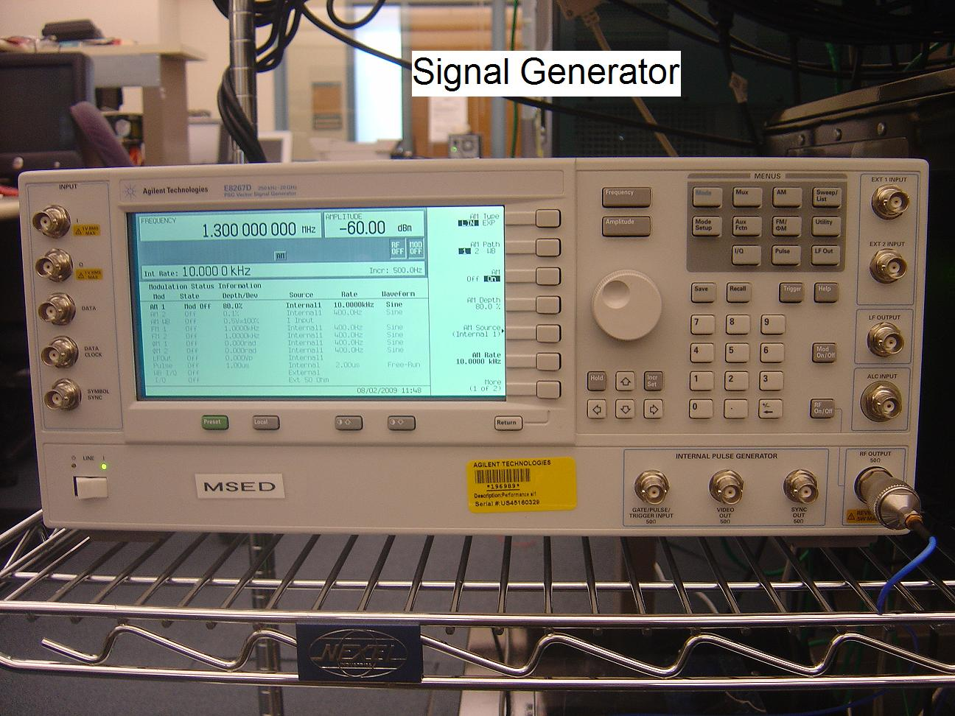
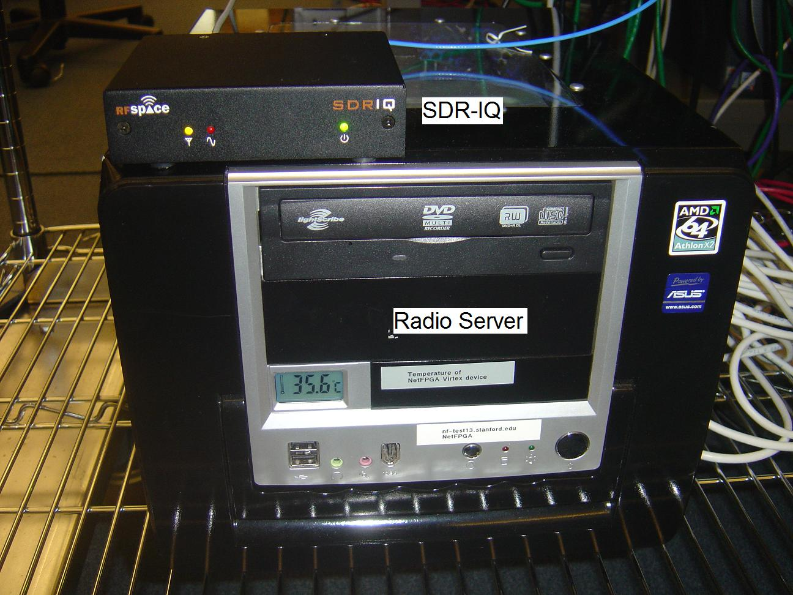
RF/Coaxial
IQ/USB

Slide 23
Work in Progress
A basic AirFPGA testbed has been implemented
USB based SDR-IQ as RF Frontend
Data injected into packet generator via USB-PCI-SRAM tunnel
Produces standard UDP/IP packet
Still working on GPIO based RF daughterboard to avoid low speed USB/PCI

Slide 24
Demo

Slide 25
Backup Slide
Why not use PC’s native ethernet port?
AirFPGA is purely hardware based
PCI-e v3.0 1GB/s with DMA overhead
PCI-e v2.0 500MB/s with DMA overhead

